Slide 1
Comets

Slide 2
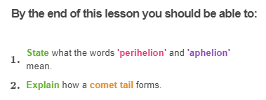
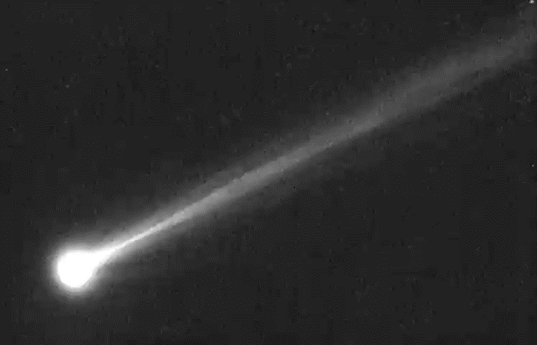

Slide 3
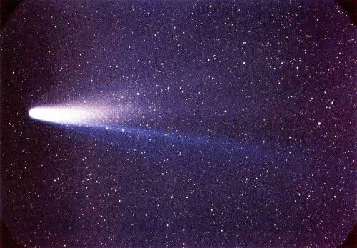
Planets, dwarf planets, stars and constellations aren't the only things in the sky!
There are thousands of chunks of rocks and ice out there too.
These chunks are more commonly known as asteroids and comets.
In this lesson you will learn all about comets.

Slide 4
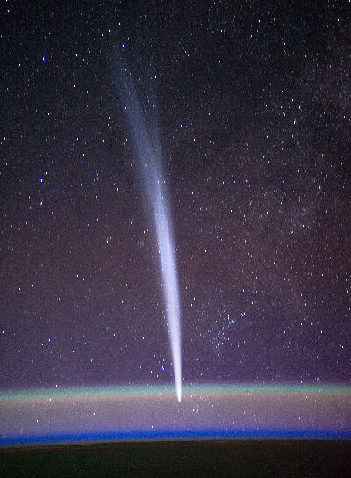
When viewed from Earth, comets have a distinctive coma (fuzzy atmosphere) at their head and a trailing 'tail'.
They gradually get brighter and then fade over a period of weeks, and they reappear in the sky periodically.

Slide 5
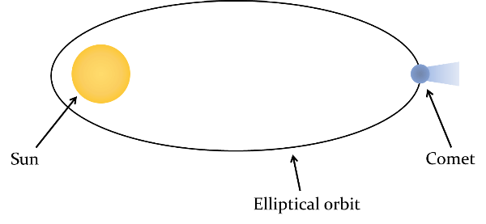
Comets orbit the Sun with highly elliptical orbits.
This means they get both very close to the Sun and very far away.
The orbital period is the time it takes for the comet to orbit around the Sun once.
The diagram below shows the shape of a comet's orbit around the Sun.

Slide 6
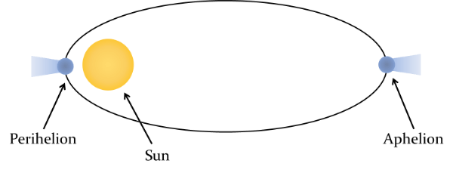
The 'perihelion' and the 'aphelion'
The point of a comet's orbit where it is closest to the Sun is called the perihelion.
The point where it is furthest away from the Sun is called the aphelion. A helpful way to remember this is: Aphelion = Away from the Sun.

Slide 7
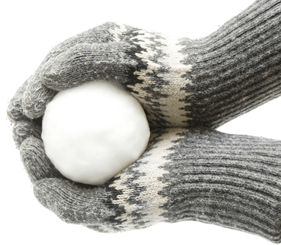
What are comets made up of?
Comets are commonly referred to as 'dirty snowballs', since they are made primarily of ice, mixed with frozen carbon dioxide and other carbon-based molecules.

Slide 8
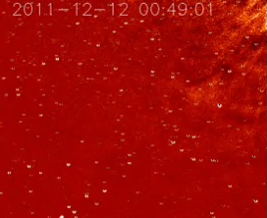
The Sun's heat and radiation produce a wind called the solar wind, which blows outwards from the Sun.
Since comets are made primarily of ice, when they get close to the Sun (approaching the perihelion) they begin to melt.

Slide 9
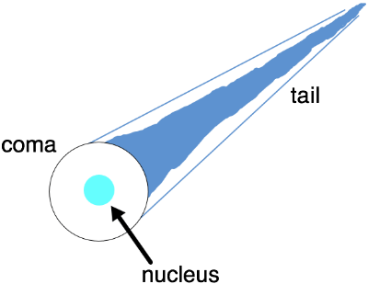
Comets have a small rocky core called the nucleus.
As the comet gets close to the sun, the ice on the surface of the nucleus turns into a gas, forming a cloud called the coma. Radiation from the sun pushes some of this gas as well as dust particles away from the coma, forming the tail.

Slide 10
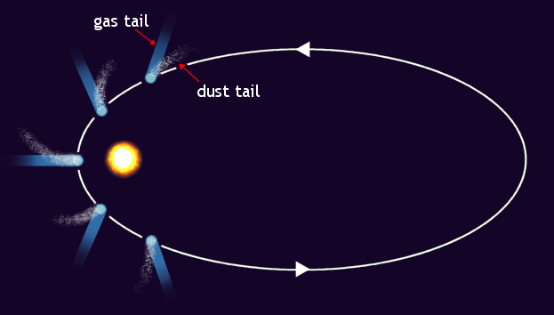
The gas and dust that melt off the comet when it gets close to the Sun are blown away from the Sun by the solar winds.
This means that comet tails always point away from the Sun, regardless of the direction in which the comet is travelling.

Slide 11
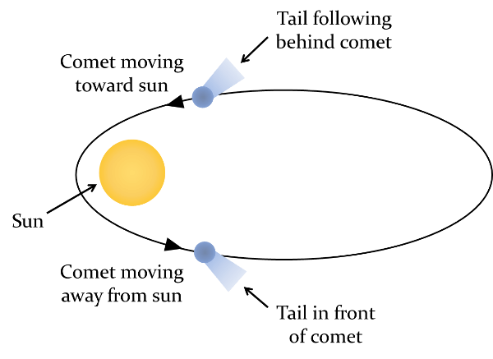
The solar wind from the Sun blows the comet's tail away from the Sun at all times.
This means that if the comet is travelling towards the Sun then the tail will follow behind. If the comet is travelling away from the Sun the tail will be in front of the comet.

Slide 12
Halley's Comet is the most well known comet.
It is known as a periodic comet (or short term comet) because the time it takes to orbit the Sun is less than 200 years.
In 1705, an astronomer named Edmond Halley discovered that the comet appears every 75 to 76 years. The last appearance of Halley's Comet occurred in 1986. The next appearance of Halley's Comet will not occur until 2061! Something to look forward to!

Slide 14
